Slide 1
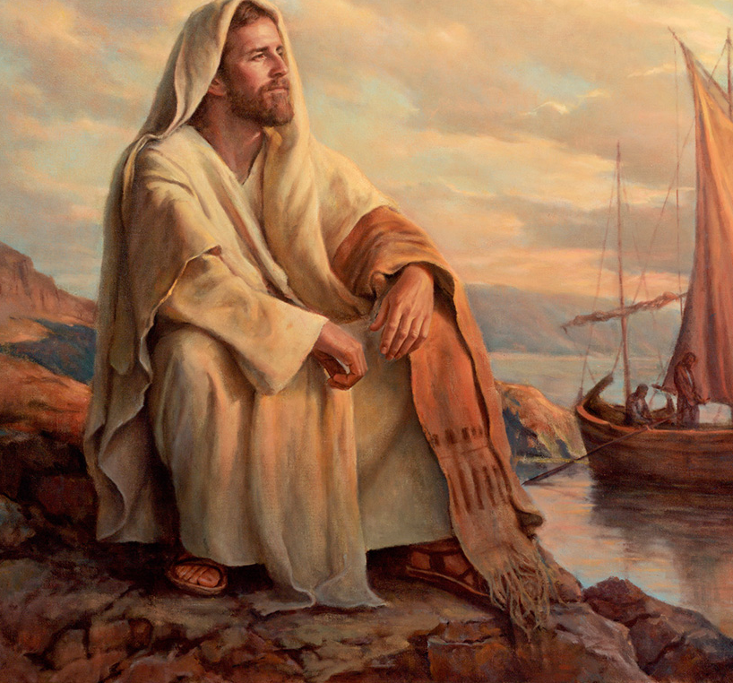
The Life of Christ

Slide 2

Seven Periods of Jesus’ Life
Years of Preparation
Beginning of Ministry
Great Galilean Ministry
Periods of Retirement
Close of Ministry
Last Week
Resurrection and Exaltation

Slide 3
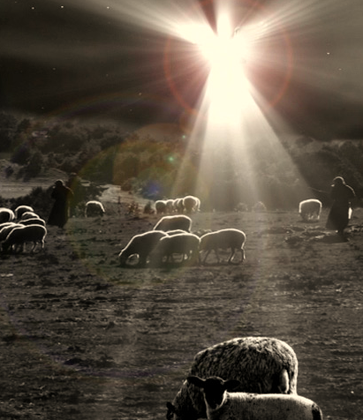
Angels Announce Jesus’ birth to Shepherds (Luke 2:8-20)
Shepherds in the region of Bethlehem were watching over their flocks at night when an angel appears to them; the Lord’s glory shines down on them.
The angel tells the Shepherds, “Do not be afraid, for behold, I bring you good tidings.”
The angel announces that a Savior is born in the city of David – Christ the Lord!
The sign that would identify the child is that they would find Him “lying in a manger.”

Slide 4
Angels Announce Jesus’ birth to Shepherds (Luke 2:8-20)
Suddenly there was with the angel a multitude of the heavenly host praising God and saying: “Glory to God in the highest, and on earth peace, goodwill toward men!”
When the angels departed, the shepherds agreed to go together to Bethlehem to find the newborn babe.

Slide 5
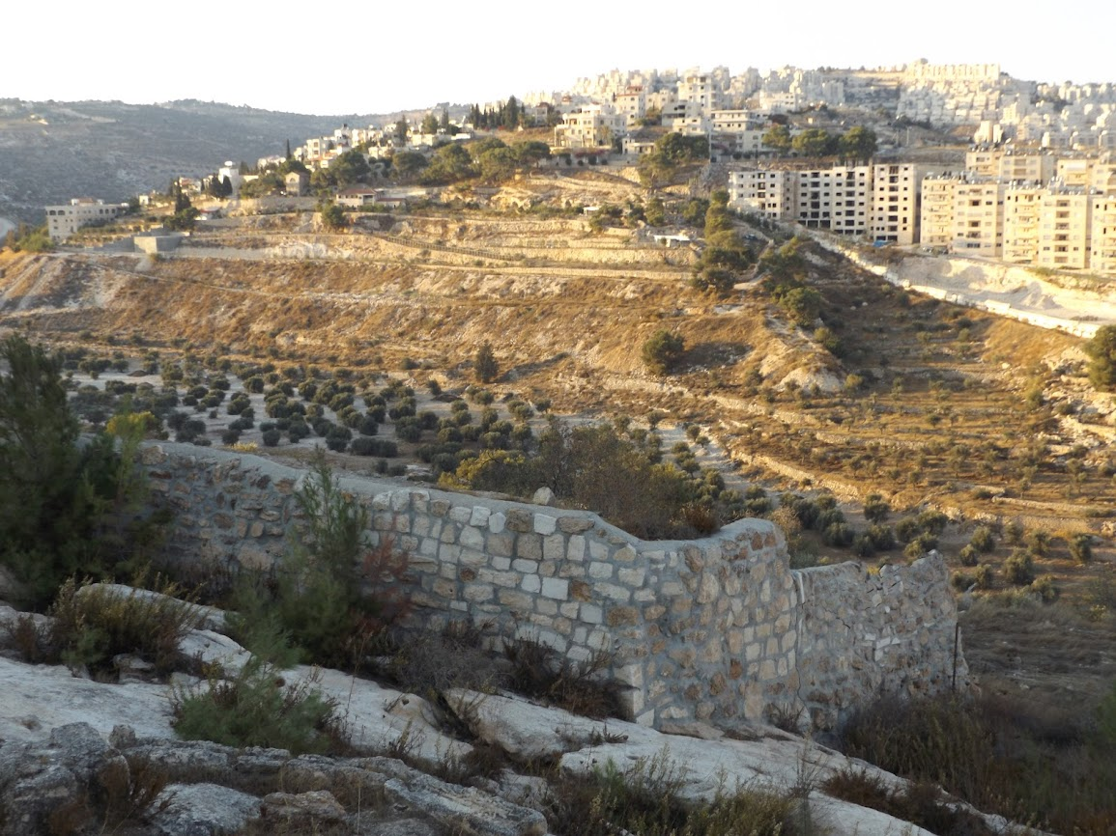
Environs of Bethlehem

Slide 6
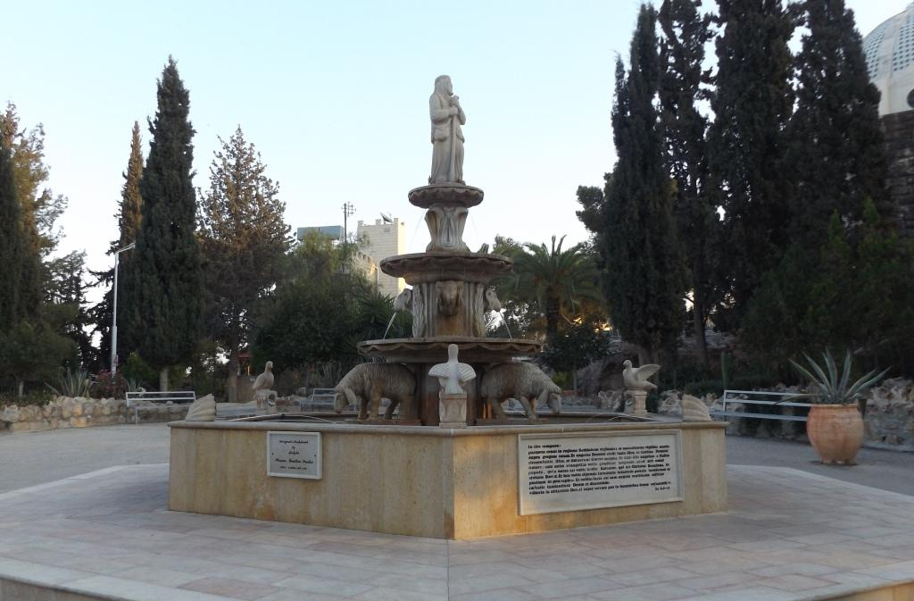
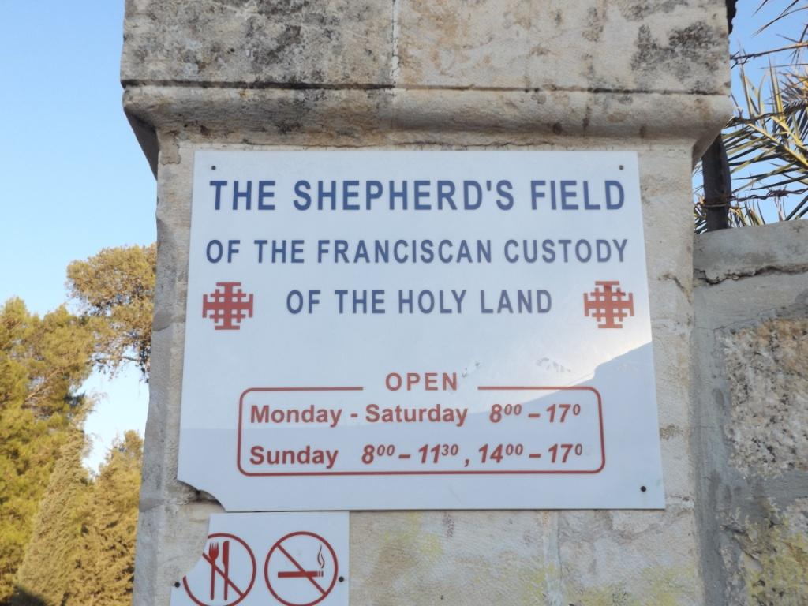

Slide 7
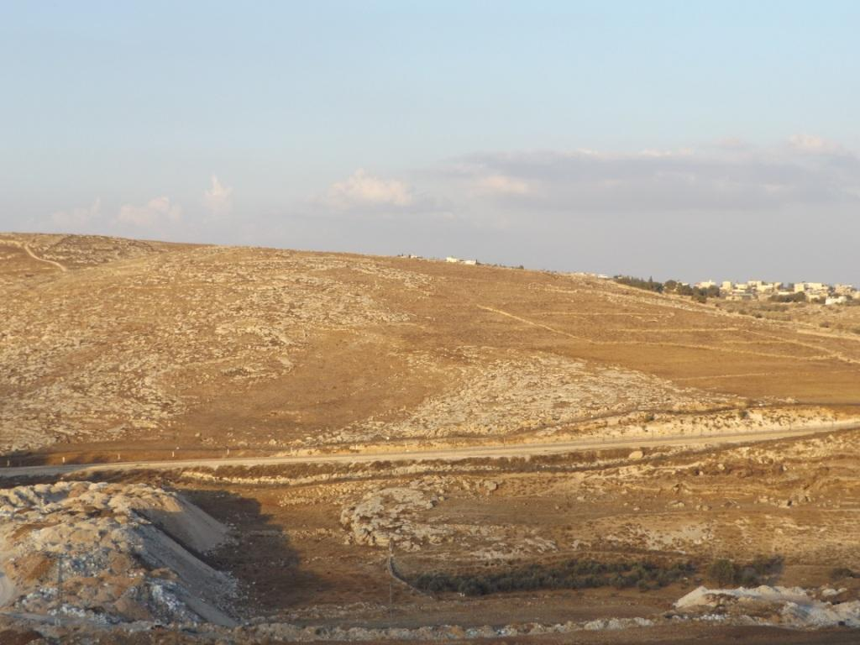
Fields near Bethlehem

Slide 8
The Church of the Nativity
Manger Square, Bethlehem

Slide 9
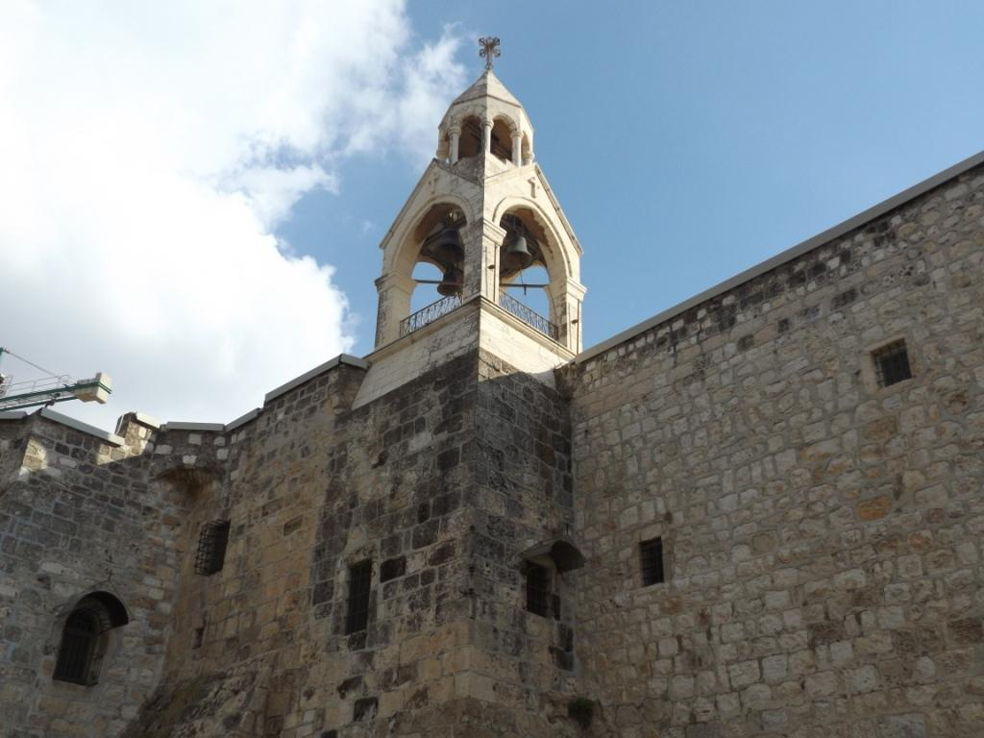
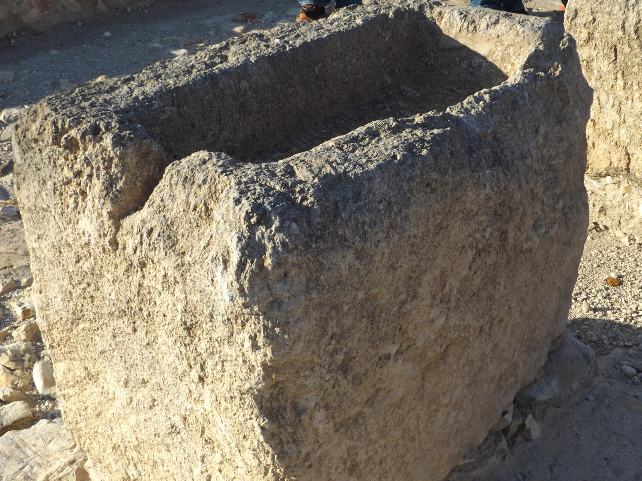
The Shepherds visit Baby Jesus (Luke 2:16-19)
The shepherds found the babe lying in a manger, just as the angel had said.
After leaving, the shepherds made the story of what happened widely known, and many marveled.
Mary preserved these events in her heart and pondered them.

Slide 10
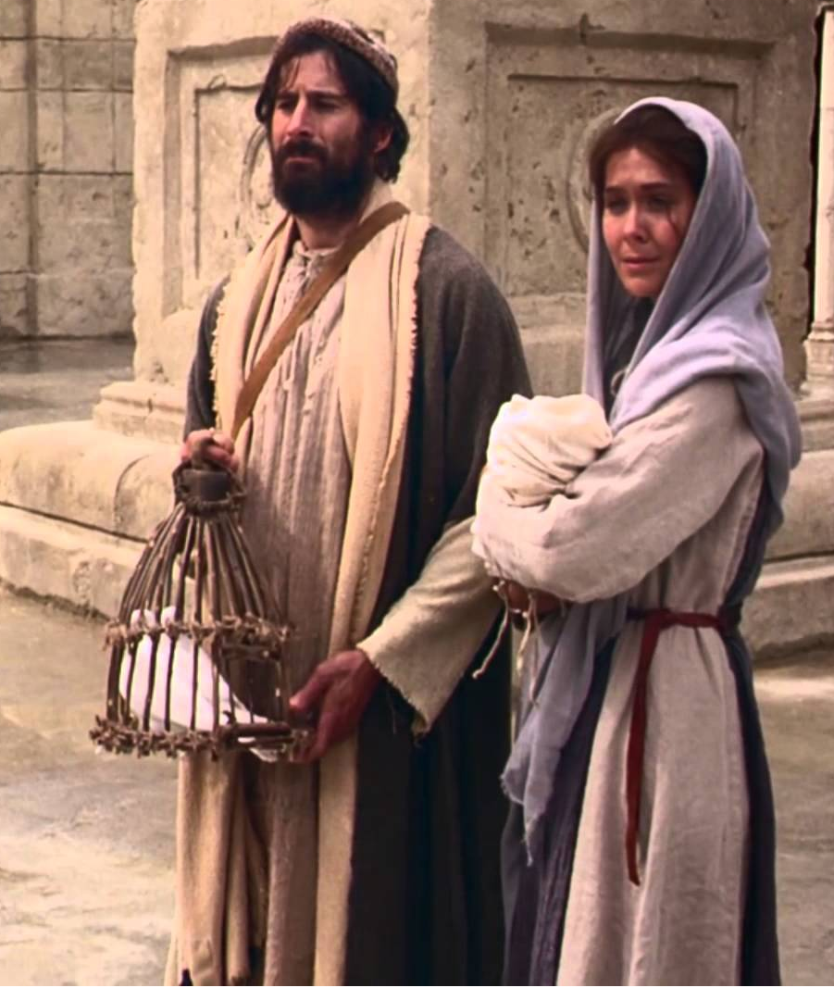
Jesus’ Circumcision & Presentation in the Temple (Luke 2:21-24)
Eight days after His birth, Jesus was named and circumcised. (cf. Gen. 17:12; Lev. 12:3).
Mary and Joseph brought Jesus to be presented in the temple after the days of her purification.
This would have been 33 days after Jesus’ birth (Leviticus 12:1-4).
A new mother was to offer sacrifices according to the Law (Leviticus 12:6-8).
The fact that pigeons or doves were sacrificed in this case indicates the physical circumstances of Joseph and Mary may not have been ideal.
Notes:
Genesis 17:12 He who is eight days old among you shall be circumcised, every male child in your generations, he who is born in your house or bought with money from any foreigner who is not your descendant.
Leviticus 12:3 And on the eighth day the flesh of his foreskin shall be circumcised.
Science indicates that the eighth day is an optimal time for circumcision. Clotting factors, immune system, less painful (nerve sensory perception), etc.
Leviticus 12:4 She shall then continue in the blood of her purification thirty-three days. She shall not touch any hallowed thing, nor come into the sanctuary until the days of her purification are fulfilled.
Leviticus 12:6 'When the days of her purification are fulfilled, whether for a son or a daughter, she shall bring to the priest a lamb of the first year as a burnt offering, and a young pigeon or a turtledove as a sin offering, to the door of the tabernacle of meeting.
Leviticus 12:8 'And if she is not able to bring a lamb, then she may bring two turtledoves or two young pigeons—one as a burnt offering and the other as a sin offering. So the priest shall make atonement for her, and she will be clean.' "

Slide 11
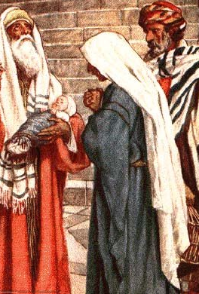
Simeon and Anna meet Jesus (Luke 2:25-38)
Simeon had been waiting for the
Consolation of Israel.
The Holy Spirit had revealed to him that, before his death, he would see the Christ.
Simeon blesses God who has allowed him to see His salvation – a light to bring revelation to the Gentiles.
He speaks to Mary of her Son’s impactful future.
Anna was of the tribe of Asher. She was at least 84 years old. She stayed night and day in the temple worshiping.
“She gave thanks to the Lord and spoke of Him to all those who looked for redemption in Jerusalem.”

Slide 12
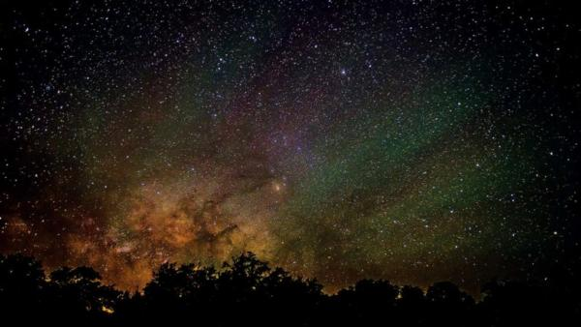
Wise men visit Jesus (Matthew 2:1-12)
Wise men came from the East.
They were in search of the One who was born “King of the Jews,” for they had seen His star in the East.
Why would Herod and all Jerusalem be “troubled”?
How did the Jewish leaders know where the new King was to be born (Micah 5:2)?
Herod instructs the wise men to go to Bethlehem and send him word when they find the child.
The star guides the wise men to the exact location of the HOUSE in which the YOUNG CHILD was staying.
They gave gifts of gold, frankincense and myrrh.
Notes:
Frankincense is a resin that comes from the Boswellia tree and has many uses, including:
Incense: Frankincense has been used in religious ceremonies for thousands of years.
frankincense can be expensive, especially in its purest form as an essential oil:
Price: Pure frankincense essential oil can cost up to $6,000 per liter.
Quality: The quality of frankincense resin is determined by its color and size. The purest and most expensive frankincense is clear, white, or silvery with a hint of light green. Frankincense Sacra from Oman is considered the most valuable and expensive variety.
Frankincense has been used for over 5,000 years in medicine and ceremony. It was highly valued in ancient times by the Egyptians, Greeks, and Romans, who used it in rituals. The trees that produce frankincense are native to the Arabian Peninsula and Northeast Africa, and are almost impossible to grow outside of that region. This made frankincense in high demand and expensive to transport.
Myrrh is a fragrant, yellow resin that comes from the Commiphora tree, a small, thorny tree that is native to Africa and the Arabian Peninsula. It has been used for thousands of years in medicine, perfumery, and incense.
Yes, myrrh can be expensive, ranging from $7–$24 per ounce. In the past, myrrh was even more valuable, with some estimates putting its price at $4,000 per pound when the wise men brought it as a gift to baby Jesus

Slide 13
The Significance of the Incarnation (John 1:1-18)
“The Word became flesh…”
The Word was in the beginning with God and was Himself God – the One through whom all things were created.
The Word is Life and Light.
“The Word became flesh and dwelt among us.”
John the Baptist testified to the identity of the Word.
Believers in the Word can become children of God.
The Word brought Grace and Truth!
The Word is the Only Begotten Son of God.
The Word communicates God – He declares God to us!

